Slide 1


Business Management for IT
(IT3090)
Accounting and Finance
Lesson 6
Chalani Kuruppu
MLRHRM (Col.), PGD.LRHRM (Col.) BBA (Hons) (Sheffield Hallam),

Slide 2
Learning outcomes
Identify the definition of accounting.
Understand the Elements of Accounting.
Understand the Accounting Equation.
Identify different types of sources of finance

Slide 3
Definition of Accounting
“The process of identifying, measuring and communicating economic information to permit informed judgments and decisions by users of the information ”
- American Accounting Association

Slide 4

Users of financial statements
Owners/Shareholders
Management
Employees
Suppliers
Customers
Lenders
Government
Potential Investors
General Public

Slide 5
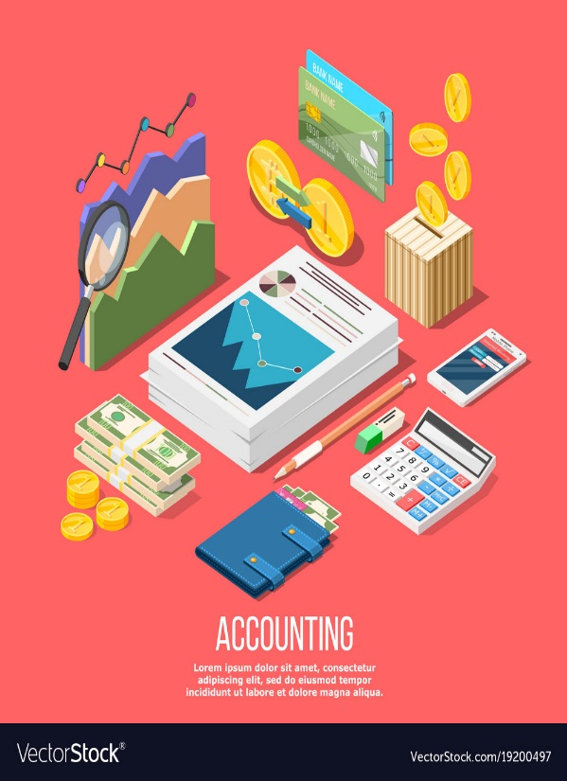
Elements of Accounting
Assets
Liabilities
Capital
Income
Expenditure

Slide 6
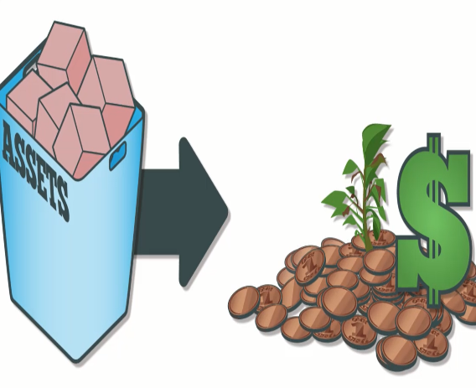
What is an Asset?
Asset is a resource controlled by the business from which future economic benefits are expected to flow, arising out of past transaction or event.
The three essential characteristics of assets are;
Future economic benefits
Owned or controlled by the business
Arisen from past event or transaction

Slide 7


Categorization of Assets-I
Fixed Assets
Are not bought primarily to be sold
Are bought to be used in the business
Are expected to be of use to the business for a long time.
E.g. Land, buildings, machinery, vehicles
Current Assets
Are likely to change in the short term and certainly within twelve months of the balance sheet date.
E.g. Stocks, trade debtors , cash in hand and bank

Slide 8
Categorization of Assets - II
Tangible Assets
Are assets that have a physical existence (i.e. they can be touched).
E.g. Buildings, machinery, land, vehicles
Intangible Assets
Are identifiable non-monetary assets that can not be seen, touched, or physically measured, which are created through time and/ or effort and that are identifiable as a separate asset.
E.g. Goodwill, patents, copyrights, trade marks, brand names

Slide 9

What is a Liability?
Present obligation of the entity arisen from past events, the settlement of which is expected to result in an outflow from the entity’s resources embodying economic benefits.
Current Liabilities
E.g. Trade creditors
Long-term liabilities
E.g. Long-term bank loans, Debentures

Slide 10

What is Capital?
Capital is an investment of money (funds) in a business with the intention of earning a return.
In other words, residual in the assets of the entity after deducting all it’s liabilities.
E.g. Sole proprietor – personal funds
Company – share capital

Slide 11

What is an Income?
Increase in economic benefits during the accounting period in the form of inflows, which eventually results in receiving money. Revenue increases profits.
E.g. sales revenue, interest received

Slide 12
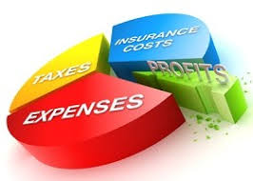
What is an expense?
Decrease in economic benefits during the accounting period in the form of out flow. Costs used up in the activities of the organization.
E.g. inventories consumed
electricity consumed
advertising costs

Slide 13
The Accounting Equation
ASSETS = CAPITAL +LIABILITIES
Assets of the business show what resources the business owns & controls.
Liabilities & capital show who contributed these resources to the business and how much each group contributed.
E.g.
Assets = Owner’s equity + Liabilities
1,750,000 = 1,000,000 + 750,000

Slide 14
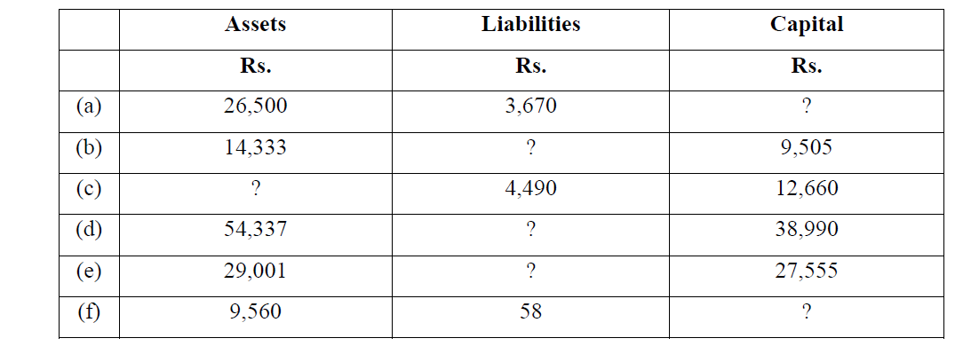
Activity 1-Complete the gaps in the following table

Slide 15
Answer
 | Assets | Liabilities | Capital
 | Rs. | Rs. | Rs.
(a) | 26,500 | 3,670 | 22,830
(b) | 14,333 | 4,828 | 9,505
(c) | 17,150 | 4,490 | 12,660
(d) | 54,337 | 15,347 | 38,990
(e) | 29,001 | 1,446 | 27,555
(f) | 9,560 | 58 | 9,502

Slide 16
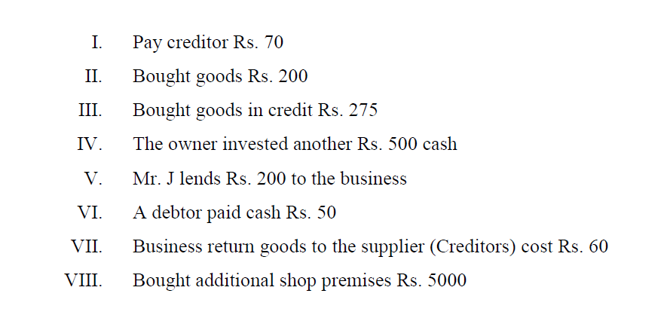
Activity 2- Apply following transactions to the Accounting equation.

Slide 17
Answer
 | Assets = | Capital + | Liabilities
I | -70 (Cash) |  | - 70 (Creditors)
II | +200 (Goods) -200 (Cash)
III | +275 (Goods) |  | +275 (creditors)
IV | +500 (Cash) | +500 (Additional Capital)
V | +200 (Cash) |  | +200 (Mr. J)
VI | +50 (Cash) - 50 (Debtor)
VII | - 60 (Goods) |  | -60 (Creditor)
VIII | +5000(Shop Premises) - 5000 (Cash)
 | 845 = | +500 | +345

Slide 18
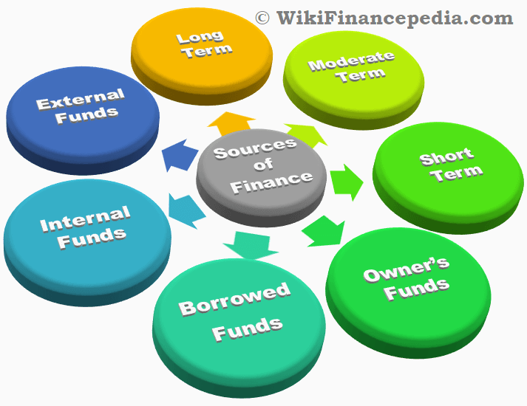
Sources of Finance

Slide 19
Types of Sources of Finance
Internal sources : Finance that come from owners.
External sources : Finance provided by banks, other institutional lenders and creditors.

Slide 20
Internal Sources of Finance
Own capital-This is a common source of finance especially for start up business that provide by the individuals who form the business – entrepreneurs.
Personal Saving –The amount of money that a business person or partner has at their disposal
Sale of assets –Business can raise funds by selling its assets where they could finance in new activities or pay- off debts.

Slide 21
External Sources of Finance
Debentures – debentures are secured loans and are said to have either fixed or floating charges with them.
Overdraft facilities – Short term loan arrangement made with bank on current accounts.
Hire purchase – method of acquiring assets without having to invest full amount in buying them.
Bank loans – long term source of finance often used to buy fixed assets such as machinery ,vehicles ,etc.

Slide 22
Recommended Text
Financial Accounting in Sri Lanka-Chapter1 (23pg-41pg)
Frank Wood’s Business Accounting 1

Slide 23
END

